Slide 1

Context-Free Grammars and Constituency Parsing

Slide 2
Contents
Introduction to Context-Free Grammars (CFG)
CFG Rules (Productions)
Constituency Parsing
Parse Trees
Ambiguity in CFG and Parse Trees
Top-Down Parsing
Bottom-Up Parsing
Constituency Parsing Algorithms

Slide 3
Introduction to CFG
Context-Free Grammars (CFG)
  Context-Free Grammars (CFG) are a formal framework used to describe the syntax of languages, whether they are natural languages like English or programming languages like Python.
  CFGs provide a structured way to define the rules governing the formation of valid sentences or sequences within a language.

Slide 4
Introduction to CFG
Rules and String Generation
  CFGs consist of a set of production rules that dictate how strings can be generated in the language.
  These rules describe how different elements of the language can be combined to form more complex structures.

Slide 5
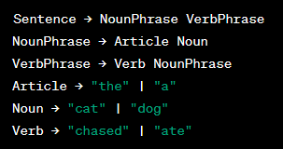
Introduction to CFG
Non-Terminals and Terminals:
  In a CFG, the language is composed of two types of symbols:
  Non-Terminals
    These are symbols that represent categories of linguistic elements or structures. They serve as placeholders for actual words or phrases and are used in the production rules to define how these elements can be combined.
  Terminals
    These are the actual words, symbols, or tokens that make up the language. Terminals are the fundamental building blocks of the language and are used as the ultimate constituents in the strings generated by the CFG.
  For example, consider a simple CFG that generates basic English sentences
In this example, "Sentence," "NounPhrase," "VerbPhrase," "Article," "Noun," and "Verb" are non-terminal symbols.
The strings generated by the CFG are formed by recursively applying the production rules and replacing non-terminals with their corresponding expansions until only terminals remain.

Slide 6
CFG Rules (Productions)
Structure of CFG Rules (Productions)
  The rules, also known as productions, in a Context-Free Grammar (CFG) have a specific structure that defines how non-terminal symbols can be replaced by sequences of symbols, which may include both terminals and non-terminals.
  The basic structure of a CFG rule is as follows:

Slide 7
CFG Rules (Productions)
Rules and Replacements
  Each rule specifies how a particular non-terminal symbol can be replaced with a specific sequence of symbols, allowing for the construction of larger linguistic structures.
  The right-hand side of the arrow (→) contains the sequence of symbols, which can include both terminal symbols (actual words or symbols) and non-terminal symbols (placeholders).
  Example Rule:
    In this rule, "NounPhrase" is the non-terminal symbol being replaced, and the sequence "Article Noun" is the replacement. Here, "Article" and "Noun" can be terminal symbols representing specific words.

Slide 8
CFG Rules (Productions)
Applying Rules
  The application of rules involves recursively replacing non-terminals with their corresponding expansions based on the given production rules.
  This process continues until only terminal symbols remain in the generated string.
  For instance:
    using the rule mentioned earlier, the non-terminal "NounPhrase" can be replaced with the sequence "Article Noun."
    If "Article" expands to "the" and "Noun" expands to "cat," the generated string would be "the cat."

Slide 9
Constituency Parsing
Concept
  Constituency parsing is the process of analyzing a sentence and determining its hierarchical syntactic structure based on the rules of a Context-Free Grammar (CFG).
  It involves breaking down a sentence into its constituent parts, which are smaller linguistic units such as phrases and words, while adhering to the grammatical rules defined by the CFG.

Slide 10
Constituency Parsing
Hierarchical Structure and Phrases
  Constituency parsing aims to identify the hierarchical relationships among the words in a sentence.
  It breaks down the sentence into phrases (also known as constituents), which are groups of words that function as single units within the sentence's grammatical structure.
  These phrases include noun phrases (NP), verb phrases (VP), prepositional phrases (PP), and more, each with a specific grammatical role.

Slide 11
Constituency Parsing
For example
  Consider the sentence "The cat chased the mouse under the table." Constituency parsing would break down this sentence into the following constituents:
    Noun Phrase (NP) : "The cat"
    Verb Phrase (VP) : "chased the mouse"
    Prepositional Phrase (PP) : "under the table"
  Each phrase further contributes to the hierarchical structure of the sentence, with constituents nesting within one another based on the grammatical relationships defined by the CFG rules.

Slide 12
Parse Trees
Concept
  Parse trees are graphical representations used to visualize the syntactic structure of sentences according to the rules of a Context-Free Grammar (CFG).
  They provide a visual way to depict how words in a sentence are combined into phrases and how these phrases are further organized hierarchically.

Slide 13
Parse Trees
Nodes Representing Constituents
  In a parse tree, each node represents a linguistic unit, which can be a constituent or a word.
  Constituents are phrases that are formed by combining words based on the CFG rules.
  Words, also known as terminals, are the actual words in the sentence.

Slide 14
Parse Trees
Role of Terminals and Non-Terminals
  Terminals (Leaves)
    Terminal nodes in a parse tree correspond to the actual words in the sentence. They are the smallest units and do not further expand into other constituents.
    Terminals are the leaves of the parse tree.
  Non-Terminals (Internal Nodes)
    Non-terminal nodes correspond to constituents generated by applying CFG rules.
    Each non-terminal node has child nodes that represent the components of the constituent it generates.
    Non-terminals are the internal nodes of the parse tree.

Slide 15
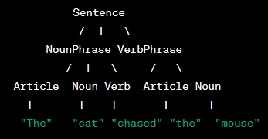
Parse Trees
Example Parse Tree
  Consider the sentence "The cat chased the mouse.“
  Here's a simplified example of a parse tree for this sentence
In this parse tree:
"Sentence" is the root node, representing the entire sentence.
"NounPhrase" and "VerbPhrase" are non-terminal nodes representing the noun phrase and verb phrase, respectively.
"Article," "Noun," and "Verb" are terminal nodes representing the actual words.
The arrows indicate how constituents are combined to form the hierarchical structure of the sentence.

Slide 16
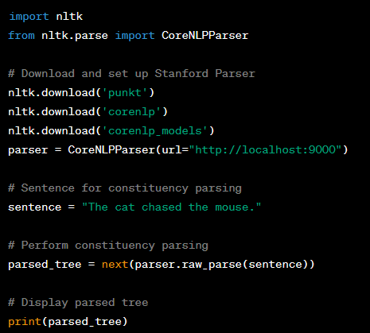
Parse Trees
Python implementation
We use the nltk library to perform constituency parsing.
We first download the necessary resources using the nltk.download function.
We create a CoreNLPParser instance and specify the URL of a Stanford CoreNLP server. You need to have a CoreNLP server running to use this approach.
We provide a sentence for constituency parsing.
The parser.raw_parse method parses the sentence and returns a parsed tree.
We print the parsed tree to visualize the constituency parsing result.

Slide 17
Ambiguity in CFG and Parse Trees
Ambiguity in the context of Context-Free Grammars (CFG) and parse trees refers to a situation where a single sentence can be parsed into multiple valid syntactic structures.
It occurs when different combinations of rules in the grammar can generate equally valid parse trees for the same sentence.
Ambiguity can arise due to the flexible nature of human language, where words and phrases can have multiple interpretations depending on context.

Slide 18
Ambiguity in CFG and Parse Trees
Example of Ambiguity
  Consider the sentence "Time flies like an arrow."
  This sentence can be interpreted in two distinct ways, leading to different syntactic structures:
    Time (flies like) an arrow.
    Time flies (like an arrow).
  In the first interpretation, "flies" is a verb, and "like an arrow" is a prepositional phrase modifying "flies."
  In the second interpretation, "time flies" together form a noun phrase, and "like an arrow" is an adverbial phrase describing how time flies.

Slide 19
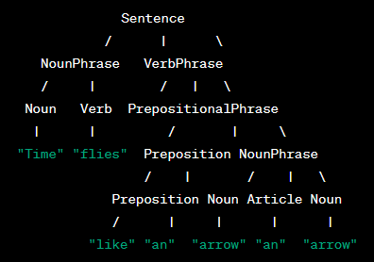
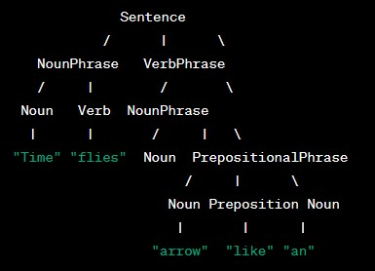
Ambiguity in CFG and Parse Trees
Parse Trees for Ambiguous Sentence
  Here are the two parse trees representing the two interpretations of the ambiguous sentence "Time flies like an arrow.“
  In both parse trees, the sentence is divided into valid constituents following the rules of the CFG.
  However, the different combinations of non-terminals and terminals result in the two different interpretations of the sentence's meaning.
Interpretation 1
Interpretation 2

Slide 20
Top-Down Parsing
Top-down parsing is a parsing approach used to construct a parse tree for a given input string based on a given Context-Free Grammar (CFG).
In this approach, parsing starts from the root of the parse tree and proceeds by recursively expanding non-terminal symbols to match the input tokens (words) of the sentence.

Slide 21
Top-Down Parsing
Steps of Top-Down Parsing
  Start from the Root
    The parsing process begins by selecting the root of the parse tree, which corresponds to the start symbol of the CFG.
  Recursive Expansion
    At each step, a non-terminal symbol at the current position in the parse tree is expanded by selecting a production rule that matches the current input token.
    This expansion continues recursively until terminal symbols are reached.
  Matching Input Tokens
    During each expansion, the selected production rule's right-hand side is compared with the current input token.
    If there's a match, the non-terminal is replaced with the sequence of symbols from the production.
    If there's no match, the parser may backtrack and try alternative production rules or sequences.

Slide 22
Top-Down Parsing
Steps of Top-Down Parsing
  Advancing Input
    As matches occur, the parser advances to the next input token and proceeds with expanding non-terminals.
  Termination
    The parsing process continues until either the entire input string is matched, leading to a successful parse, or a point is reached where no valid production rule matches the current input token, indicating a parsing error.

Slide 23
Top-Down Parsing
Two common methods for implementing top-down parsing are
  Recursive Descent Parsing
    In this approach, a set of recursive procedures (functions) is implemented, each corresponding to a non-terminal in the grammar.
    Each procedure handles the expansion of its corresponding non-terminal by selecting the appropriate production rule based on the current input token.
  LL Parsing:
    LL (Left-to-Right, Leftmost derivation) parsing is a specific type of recursive descent parsing that follows a predetermined order for selecting production rules.
    The LL(k) parsing algorithm uses k tokens of lookahead to decide which production rule to apply.

Slide 24
Bottom-Up Parsing
Bottom-up parsing is a parsing approach used to construct a parse tree for a given input string based on a given Context-Free Grammar (CFG).
In this approach, parsing starts from the input tokens (words) of the sentence and builds up the parse tree by reducing sequences of symbols to non-terminal symbols.

Slide 25
Bottom-Up Parsing
Steps of Bottom-Up Parsing
  Start from Input Tokens
    The parsing process begins by considering the individual input tokens as the initial symbols in the parse tree.
  Shift and Reduce
    During each step, the parser has two main actions: shift and reduce.
    Shift: The parser shifts (moves) the next input token onto a stack, indicating its presence in the current parse tree.
    Reduce: If a sequence of symbols on the stack matches the right-hand side of a production rule, the parser reduces that sequence to the corresponding non-terminal symbol.
  Building the Parse Tree
    The parser continues shifting input tokens onto the stack and reducing sequences of symbols until the entire input string is processed and reduced to the start symbol of the CFG.
    This building process forms the parse tree from the bottom (input tokens) up to the root (start symbol).
  Termination
    The parsing process continues until either the entire input string is successfully reduced to the start symbol, leading to a successful parse, or the parser encounters an error due to an inability to apply valid production rules.

Slide 26
Bottom-Up Parsing
Steps of Bottom-Up Parsing
  Start from Input Tokens
    The parsing process begins by considering the individual input tokens as the initial symbols in the parse tree.
  Shift and Reduce
    During each step, the parser has two main actions: shift and reduce.
    Shift: The parser shifts (moves) the next input token onto a stack, indicating its presence in the current parse tree.
    Reduce: If a sequence of symbols on the stack matches the right-hand side of a production rule, the parser reduces that sequence to the corresponding non-terminal symbol.
  Building the Parse Tree
    The parser continues shifting input tokens onto the stack and reducing sequences of symbols until the entire input string is processed and reduced to the start symbol of the CFG.
    This building process forms the parse tree from the bottom (input tokens) up to the root (start symbol).
  Termination
    The parsing process continues until either the entire input string is successfully reduced to the start symbol, leading to a successful parse, or the parser encounters an error due to an inability to apply valid production rules.

Slide 27
Bottom-Up Parsing
Two common methods for implementing bottom-up parsing are
  Shift-Reduce Parsing
    In this approach, the parser alternates between two actions: shifting input tokens onto the stack and reducing sequences of symbols when they match the right-hand side of a production rule.
    Shift-reduce parsers often use finite automata or state machines to guide their decisions.
  LR Parsing
    LR (Left-to-Right, Rightmost derivation) parsing is a specific type of shift-reduce parsing that follows a predetermined order for making shift and reduce decisions.
    The LR(k) parsing algorithm uses k tokens of lookahead to decide whether to shift or reduce.

Slide 28
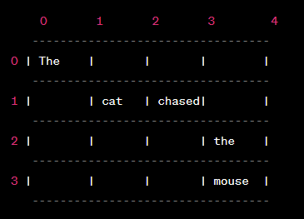
Constituency Parsing Algorithms
Earley Parser
  The Earley parser is a chart-based parsing algorithm that uses dynamic programming to efficiently handle ambiguity and generate all possible parse trees for a given sentence.
  It was developed by Jay Earley.
  The algorithm operates by predicting, scanning, and completing items in a chart.
  It can handle CFGs with arbitrary rules and is capable of parsing sentences with multiple valid structures.
Example in sentence:
"The cat chased the mouse."

Slide 29
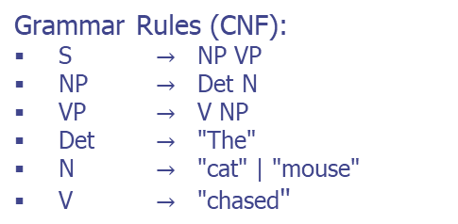
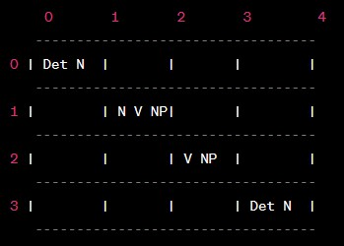
Constituency Parsing Algorithms
CYK Parser (Cocke-Younger-Kasami)
  The CYK parser is a dynamic programming algorithm used for parsing sentences based on CFGs.
  It was independently developed by John Cocke, Daniel Younger, and Tadao Kasami.
  The CYK parser works by constructing a parsing table where each cell stores possible constituents that can generate the substring of the sentence.
  It is particularly well-suited for grammars in Chomsky Normal Form (CNF), where production rules are limited to specific forms.
Sentence "The cat chased the mouse."
The parsing table for the sentence

Slide 30
Constituency Parsing Algorithms
Chart Parsing
  Chart parsing is a general parsing strategy that uses a chart data structure to store and manipulate partial parse trees.
  The chart is a table where cells correspond to substrings of the input sentence.
  Each cell stores possible constituents that can generate the substring in the cell.
  Chart parsing algorithms, like the Earley parser and CYK parser, build parse trees by incrementally adding constituents to the chart and combining them based on CFG rules.
Example of chart entries for the sentence "The cat chased the mouse.“
The chart is populated with possible constituents, and the parsing algorithm combines them to form parse trees.

Slide 31
Q & A

